Slide 1
Board of regents support fund
PROGRAM CHANGES
FY 2017-18

Slide 2
BOARD OF REGENTS SUPPORT FUND
Constitutional definition & Requirements
Two Postsecondary Education Goals Framed as Equal:
Improve the Quality of Higher Education
Enhance Economic Development in Louisiana
Expenditures Permitted for “Any or All” of the Following:
Carefully Defined Research Efforts
Endowment of Chairs for Eminent Scholars
Enhancement of the Quality of Academic, Research or Agricultural Departments or Units Within a Post-Secondary Institution
Recruitment of Superior Graduate Students

Slide 3
changes across Borsf: APPROVED 11/16
Align all investments with BoR’s “Educate and Innovate” focus, State/system/campus strategic priorities, and campus roles, scopes and missions
Replace large number of small, highly specific, limited-impact programs with fewer programs emphasizing greater impact and flexibility
Add workforce emphasis across Support Fund programs
Replace individual faculty-driven Enhancement grants with competitive funding at the departmental/unit/center level
Increase support for innovation in the marketplace, particularly related to LA: research commercialization and industrial partnerships
Broaden impact by requiring undergraduate and graduate student participation in research, educational, and training opportunities
Allow for completion of contracts and endowment matching requests already in place

Slide 4
Board of Regents Support Fund Programs FY 2017-18
Endowed Chairs
Recruiting and retaining game-changing faculty – matches private contributions to establish chairs in increments of $1 million
Graduate Fellows
(Endowed Grad Scholarships)
Attracting the highest quality students to Louisiana for research & study in key programs – establishes permanent endowed scholarship funds for superior students in departments with existing or prospective eminence
Research & Development
(Research Competitiveness Industrial Ties/Proof-of-Concept Awards to LA Artists & Scholars)
Building competitiveness & partnerships to contribute to fundamental knowledge and economic development – funds summer research time, student support, travel, supplies, market research studies, and equipment/supplies
Enhancement
(Departmental BoR/SREB Professorship & Two-Yr. Workforce Scholarship Endowments Federal Matching)
Foundational support for academic & research programs/units – funds instructional and research equipment and supplies, curricular redesign efforts, student experiences, visiting speakers, endowment matching, and other academic support activities.
www.regents.la.gov

Slide 5
Effect on Borsf competitive PROGRAMs
Substantially Revise:
Departmental Replaces Traditional Enhancement
Departmental projects with comprehensive and targeted options
Open to all formally constituted departments, units, centers, etc. on eligible campuses
Discipline rotation: two cycles in alternating years
BoR/SREB doctoral support retained through separate RFP as part of ENH program
Endowed Chairs
Emphasis on need for/appropriateness of Chair and alignment with campus and assigned unit’s role, scope, mission and strategic priorities
Four types of chair by primary expected role/contribution: research, education, workforce development, and combination
Requirement to demonstrate appropriate resources committed at application for the chair to achieve the goals described

Slide 6
Effect on Borsf competitive PROGRAMs
Retain with Minimal Changes:
R&D Subprograms (RCS, ITRS-PoC/P, ATLAS)
Increase support as possible for economic development activities (ITRS-PoC/P)
Endowed Two-Year Workforce and Superior Graduate Student Scholarships
Eliminate:
Graduate Fellowships
Integrate graduate student support (no tuition – not permitted per Constitution) into Departmental Enhancement; revise BoR/SREB initiative through RFP
First-Generation Endowed Undergraduate Scholarships
Resources are insufficient to generate needed assistance for higher-risk students
Other student endowments provide more targeted support and better results

Slide 7
Departmental enhancement
program design
Objectives (LA Constitution): to enhance the infrastructure of academic, research, or agricultural departments/units and to promote economic development
Eligibility: Discipline rotation + multidisciplinary; any formally recognized academic, research or agricultural department, unit, center, etc. No administrative offices eligible except in SREB
Two award types: comprehensive (holistic departmental approach – up to five years of funding; one submission per eligible department/unit) and targeted (focused approach – one year of funding; unlimited submissions per eligible department/unit, but all submissions must be ranked)
Three categories by primary contribution: research, education, workforce development. Projects may, even should, include impacts from more than one of these areas
Multidisciplinary projects still solicited: see RFP for restrictions

Slide 8
Departmental enhancement
Proposal Development
Project focus: Projects must address Department/Unit strategic priorities within context of campus role, scope, mission & priorities
BoRSF does not define priority areas for campuses: all disciplines eligible, though projects must document and argue for alignment with department and campus role, scope, mission and strategic priorities
Broad eligibility for activities: Almost any activity is permitted that can be convincingly argued will enhance infrastructure and priority activities of participating department(s)/unit(s)
Emphasis on the depth and/or breadth of potential impact, whether educational/training (student outcomes, curricular effects, workforce opportunities) or research (capacity/competitiveness/unique assets)
Sustainability critical: if pilot or initiation of activities, how will they be sustained and paid for? If short-term only, why not sustain and what is longer-term impact? Note: for one-time purchases (equipment, software, supplies, etc.), sustainability includes maintenance/repair/updating/replenishing

Slide 9
Enhancement: BoR/SREB Initiative
PROGRAM DESIGN
Program focus: Building diversity in doctoral programs and faculty through partnership with SREB’s Doctoral Scholars Program (DSP)
$10,000 supplementary stipend + $5,000 SREB DSP membership; campus must match stipend level and cannot use BoRSF funds for costs beyond stipend and SREB membership (matching is acceptable and encouraged)
Maximum of 10 slots available per cycle
Three years of support; one submission per campus (submitted by the Graduate School or equivalent governing unit for graduate education)
Key elements:
Previous success in recruiting, retaining, and graduating URM students in doctoral programs
Concrete plans (prospective or implemented) for building URM participation and success, or maintaining URM populations if already sufficiently diverse
Inclusion of sufficiency of all funding (BoRSF + match) to attract and retain the type of student targeted

Slide 10
Endowed chairs
Policy revisions
Objective (LA Constitution): to endow chairs for eminent scholars
Four endowment types: research, educational, workforce, and combination (equal parts one or more types)
Minimum corpus remains $1M (60:40 ratio of private to BoRSF dollars), though higher recommended in resource-intensive/highly competitive programs (science, tech, engineering, business)
Proposals must document that package of resources available (endowment, salary, start-up, etc.) is sufficient to attract an eminent scholar
All disciplines eligible, though proposal must document and argue for alignment with campus role, scope, mission and strategic priorities and the appropriateness of an Endowed Chair in the defined area
Previous policy changes (November 2016) focus on use of revenues: campuses must prioritize use of dollars to support academic & research work as defined by donor/BoR; chairholders must be informed of available monies and acceptable uses, and expend annually

Slide 11
Preparation for competitions
Read the applicable RFP(s) carefully and in their entirety
Review scoring rubrics to ensure the project/proposal is fully responsive
Give sufficient time in the proposal development process for data collection, proofing, and submission before the deadline. No extensions of submission deadlines are permitted and the online system will close at 4:30 p.m. central on the deadline date
Read consultants’ reports from previous cycles (on our website: Downloads)
Request copies of previous proposals, if needed (procedure on our website: Announcements)
Call or email staff with questions as early as possible. We cannot answer questions about RFPs after November 1
Review Q&A on the BoR website, which is updated as we receive and respond to questions. We will update daily as needed

Slide 12
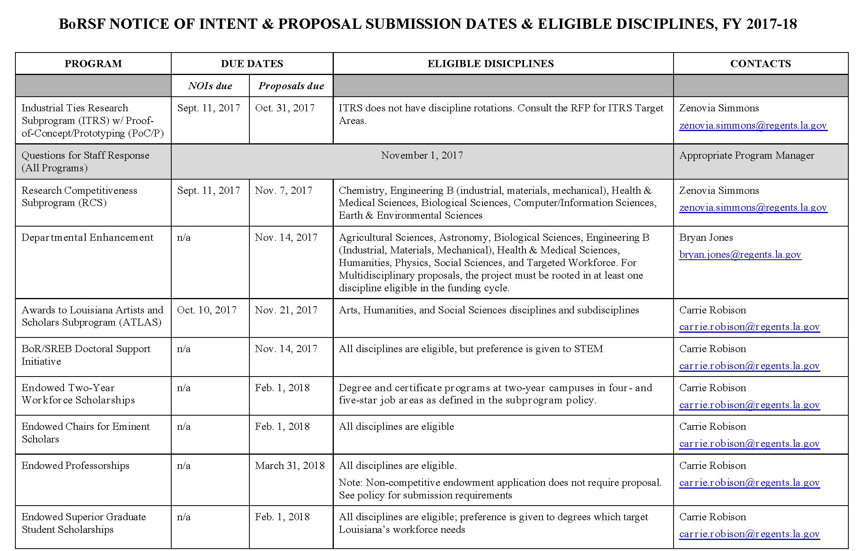

Slide 13
RFPs, POLICIES & MORE INFORMATION
https://web.laregents.org
https://web.laregents.org/programs
https://web.laregents.org/downloads_page/rfps-policies-forms
Program Managers (contact info also in RFPs):
Departmental ENH: Bryan Jones (bryan.jones@regents.la.gov)
R&D (RCS, ITRS, PoCP): Zenovia Simmons (zenovia.simmons@regents.la.gov)
ATLAS, SREB, Endowments: Carrie Robison (carrie.robison@regents.la.gov)
General Questions: Carrie Robison
Regents Phone: (225) 342-4253

Slide 14
Q&A lists and technical support
Q&As (updated throughout the question period, ending Nov. 1):
https://web.laregents.org/downloads_page/frequently-asked-question/
Technical Issues with LOGAN Access, Forms, Uploads, etc.:
support@laregents.org

